Slide 1
Zero Channel Feedback for
Next-Generation Networks
Zikun Liu
Gagandeep Singh, Chenren Xu, Deepak Vasisht
Notes:
Hello everyone, I am Zikun, a Ph.D. student from UIUC. Today, I will talk about removing channel beedback from next generation cellular networks. This is joint work with Gagandeep, Chenren, and my advisor Deepak. I will talk a lot about channel feedback, and I will tell you in a bit what channel feedback is. But

Slide 2
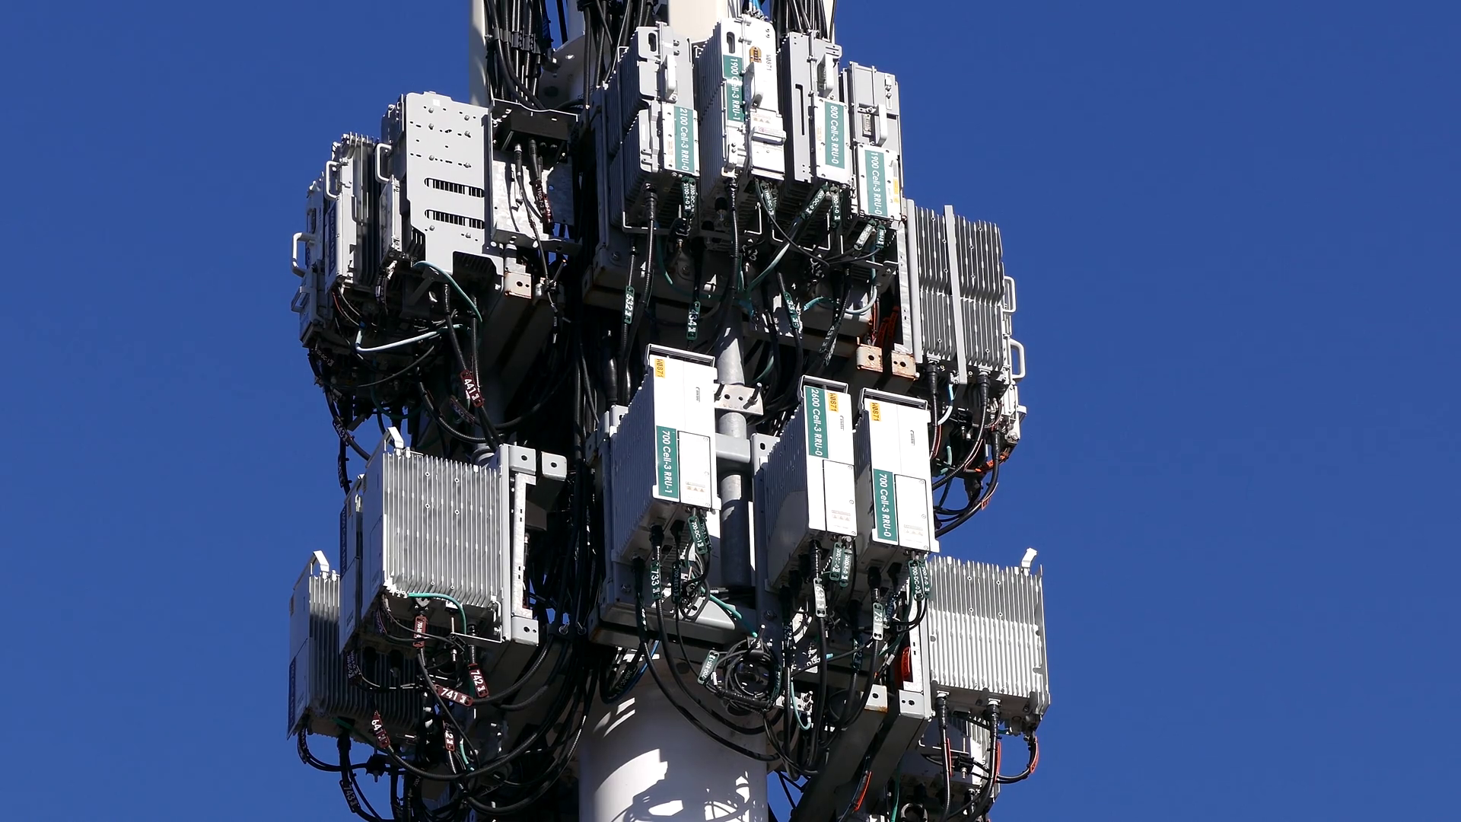
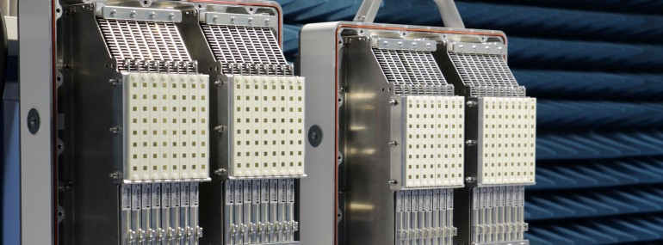
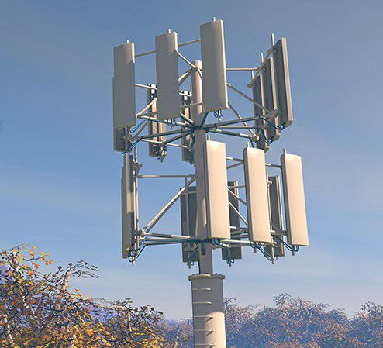
Channel Feedback is An Important Problem for NextG Networks
Cellular networks deploy many antennas at base station to increase throughput
64 to 128 antennas deployed today!
Channel feedback overhead increases linearly with the number of antennas
Up to 50% overhead with just 64 antennas!
Notes:
Channel feedback is an important problem for next generation cellular networks. Cellular network operators are deploying more and more antennas at base stations to increase the throughput, for example, Verizon has deployed 64 to 128 antennas at their base stations today. However, as the number of antennas increases, the need for channel feedback also increases. In fact, it increases linearly with the number of antennas. With just 64 antennas, the overhead can be as high as 50%. Think about it. Cellular operators pay billions of dollars to obtain cellular spectrum. And 50% of that spectrum can be wasted on just channel feedback.

Slide 3
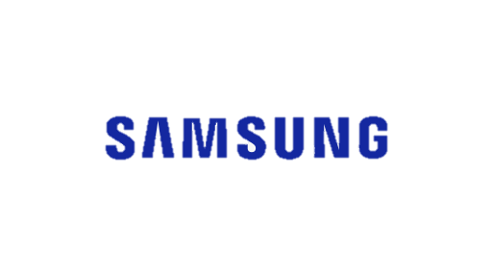
Channel Feedback is An Important Problem for NextG Networks
In academia: R2-F2 (SIGCOMM 2016), OptML (MobiCom 2019), FNN(2016), ICC 2019, IEEE Access 2019, ACSSC 2019, …
Industry
This Talk: Zero channel feedback, maximal performance!
Notes:
Both academia and industry have understood this problem and proposed various solutions. In academia, many recent papers have tried to tackle this problem. The standard body 3GPP and several companies such as Ericcson, Apple, Nokia, Samsung, and others have investigated various ways to decrease this channel feedback overhead and save spectrum. However, all the ways to reduce the feedback end up hurting the cellular network performance. In this talk, I will show you how we can achieve zero channel feedback while maintaining the same performance as full feedback!

Slide 4
In this talk: Zero Channel Feedback
Problem: What is channel feedback?
FIRE: End-to-end Machine Learning to remove channel feedback.
Evaluation using public datasets and our hardware testbed
Notes:
I will start by talking about what is channel feedback and what causes channel feedback. Then I will present to you our system called FIRE, which is an end-to-end machine learning method to remove channel feedback. Finally, I will show the evaluation results on both public datasets and our own hardware testbed.

Slide 5
In this talk: Zero Channel Feedback
Problem: What is channel feedback?
FIRE: End-to-end Machine Learning to remove channel feedback.
Evaluation using public datasets and our hardware testbed
Notes:
Let us start by talking about what is channel feedback?

Slide 6
Multi-antenna base station can support multiple clients simultaneously
But needs to know the channel values to each client!
Base Station
Clients
Notes:
As I said earlier, in cellular networks today, base stations deploy a large number of antennas. They deploy these antennas to talk to multiple users simultaneously. However, before sending data to users, base station needs to know the channel values to each of its clients!

Slide 7
Base station needs to know the channel matrix to clients
$$H_{1}$$
$$H_{2}$$
$$H_{3}$$
Base Station
Clients
Notes:
The channel values form a matrix, and the base station needs to know one channel matrix for each client. So, let’s say we name these matrices H1, H2, and H3. Each client can measure the channel from the base station to itself. The base station does not know this channel matrix yet. But it can get this channel matrix from the clients.

Slide 8
Base station needs to know the channel matrix to clients
$$H_{1}$$
$$H_{2}$$
$$H_{3}$$
Base Station
Clients
Notes:
The clients can send this channel matrix to the base station. However, sending this channel matrix is wasting resources like time and spectrum.

Slide 9
More Antennas → More Feedback Overhead
$$H_{1}$$
$$H_{2}=\left[h_{1}, h_{2}, …, h_{N}\right]$$
#Antennas
$$H_{3}$$
Base Station
Clients
Notes:
(arrow animation) The base station needs to know channel values from each antenna to the client. Therefore, the amount of data that you need to send as feedback increases linearly with the number of antennas. Recall that there are many many antennas deployed at the base station serving many clients, this overhead is huge.

Slide 10
Base station needs to know the channel matrix to clients
$$H_{1}$$
$$H_{2}=\left[h_{1}, h_{2}, …, h_{N}\right]$$
#Antennas
$$H_{3}$$
More antennas → More overhead
Base Station
Clients
Notes:
(arrow animation) These channel matrices has the size that’s proportional to the number of antennas. This means that, more antennas at the base station will bring more feedback overhead, and more clients served at the base station will also bring more feedback. Recall that there are hundreds of antennas deployed at the base station serving many clients, this overhead is huge. Now, let’s take a little step further and see how large can the overhead be.

Slide 11
Channel Feedback Overhead is Huge
With a 64-antenna base station and 8 clients, explicit channel feedback can consume over half of the throughput
Useful Data
Channel Feedback
Notes:
And Yyou need to measure this channel every few milli seconds, so with a 64 antennas base station and 8 clients, explicit feedback can consume over half of the network throughput, which means that we are wasting half of the network resources to transmit the channel feedback while only use the other half for the useful data transmission.

Slide 12
Channel Feedback Overhead is Huge
With a 64-antenna base station and 8 clients, explicit channel feedback can consume over half of the throughput
As number of antennas increases, the feedback increases
Channel Feedback
Channel Feedback
Useful Data
Channel Feedback
Useful Data
Useful Data
Antenna Number
Notes:
Secondly, this feedback will scale up linearly with number of antennas in the base station.
What can we do to deal with this feedback?

Slide 13
In this talk: Zero Channel Feedback
Problem: What is channel feedback?
FIRE: End-to-end Machine Learning to remove channel feedback.
Evaluation using public datasets and our hardware testbed
Notes:
In this work, we propose FIRE, and End-to-end Machine Learning to remove channel feedback

Slide 14
FIRE: Zero Feedback Multi-Antenna Systems
With a 64-antenna base station and 8 clients, explicit channel feedback can consume over half of the bandwidth*
As number of antennas increases, the feedback increases
Useful Data
Useful Data
Channel Feedback
Notes:
With fire, all the network resources can be used to transmit the useful data, thus achieving the zero feedback muli-antennas systems.

Slide 15
Intuition Behind FIRE
Base station knows the uplink channel, but needs downlink channel
Uplink Channel in frequency 1
Notes:
Before diving into the detailed design of fire, let’s look into the intuition behind fire. Base station knows the uplink channel which is the channel from user devices to base station. And what base station wants is the downlink channel which is in the reverse direction and also in a different frequency.

Slide 16
Intuition Behind FIRE
Base station knows the uplink channel, but needs downlink channel
Downlink channel in frequency 2 ?
Notes:
Before diving into the detailed design of fire, let’s look into the intuition behind fire. Base station knows the uplink channel which is the channel from user devices to base station. And what base station wants is the downlink channel which is in the reverse direction and also in a different frequency.
downlink channel is different from the up because cellular network in US uses FDD where up and dl frequency are different, and therefore, the reciprocity breaks.

Slide 17
Intuition Behind FIRE
Uplink and downlink share the same physical path
[R2F2 in SIGCOMM 2016, OptML in Mobicom 2019]
Notes:
(need to make the path unsymmetric)
Previous works have shown that uplink and downlink share the same physical path as they traveled in the air. Thus the downlink can be treated as the function of uplink.

Slide 18
Intuition Behind FIRE
Uplink and downlink share the same physical path
[R2F2 in SIGCOMM 2016, OptML in Mobicom 2019]
Uplink Channel
Downlink Channel
Path Parameters
Distance and angle of each path
Notes:
Thus previous works first infer the physical path parameters such as distance and angle of each path from the uplink channel using optimization algorithms, then plug in the new frequency to get the downlink channel.

Slide 19
Intuition Behind FIRE
Uplink and downlink share the same physical path
[R2F2 in SIGCOMM 2016, OptML in Mobicom 2019]
Uplink Channel
Downlink Channel
Path Parameters
Distance and angle of each path
Needs to be very precise
Notes:
But in order to get the accurate downlink channel, it needs the path parameter estimation to be very precise.

Slide 20
Intuition Behind FIRE
Uplink and downlink share the same physical path
[R2F2 in SIGCOMM 2016, OptML in Mobicom 2019]
Uplink Channel
Downlink Channel
Path Parameters
Distance and angle of each path
0.5 cm distance error reduces the SNR by 10 to 20dB
Fundamental limitation due to bandwidth!
Notes:
Even a small error, like 0.5cm in measuring distance reduce the SNR by 10 to 20 dB. In terms of data rate, this means you can go from HD video streaming to just text based browsing.
（switch）What makes it more interesting is that this limitation is fundamental. Cellular channel bandwidth is tens of MHz. With this small bandwidth, you cannot measure the distance parameters accurately.
Therefore, while past work propose a new strategy for reducing feedback, they end up getting lower performance than systems that operate with feedback.

Slide 21
Intuition Behind FIRE
Idea: Use ML to model the physical environment
Notes:
Here is an idea. If we know exactly where the big reflectors like the building and the ground are, it becomes easier to know the paths the signal will take. I can be more accurate in my estimation.Note that, the BS is always at a fixed location, so it can infer this env using multiple measurement, (switch) we use a data-driven approach to do that. We deployed a mL model on the BS to implicitly learn about the surroundings and predict the downlink channel.

Slide 22
Option 1: Use ML to infer Path Distance and Angle
Uplink
Channel
Path Parameters
Problem: No ground truth for paths
Notes:
Okay, so how can we use ML to model the environment. One option is to train a model that can take in uplink channels and predict the path parameters lik dis and angle, (switch)but the problem is how do you train this model? You don’t know the exact path that the signal travels through.

Slide 23
Option 2: Directly Predict Downlink Channels
Uplink
Channel
Downlink Channel
Problem: Does not accurately model the channel generation process
Notes:
The second option is to directly predict the downlink channels by observing the uplink channel, thus it becomes a regression task. But this option is also not accurate, because it doesn’t accurately model the physics of how wireless signals are generated.

Slide 24
Our Idea: End-to-end Generative Model using VAE
Uplink
Channel
Downlink Channel
Path Parameters
Notes:
Our idea is to use the end-to-end generative model to predict the downlink channel. Inspired by the physics-level intuition that the downlink channel is generated from the same path parameters of the uplink, we model our architecture using a generative process. Specifically, we choose a variant of the popular variational autoencoders (VAE) as our end-to-end architecture,.

Slide 25
Network Architecture
Uplink
Channel
Downlink Channel
Path Parameters
Encoder
Uplink Channel
Notes:
The VAE first takes the input channel and send it into the encoder neural network which ……, it infers a latent low-dimensional representation of the underlying process of channel generation, and then (b) generates the downlink channels by sampling in this low-dimensional space

Slide 26
Network Architecture
Uplink
Channel
Downlink Channel
Path Parameters
Encoder
Latent Space
μ
Uplink Channel
z
σ
ε
$$\text{ε}\text{ \sim }\text{N}\text{(0,}I\text{)}$$
Notes:
The VAE first takes the input channel and send it into the encoder neural network which ……, it infers a latent low-dimensional representation of the underlying process of channel generation, and then (b) generates the downlink channels by sampling in this low-dimensional space

Slide 27
Network Architecture
Uplink
Channel
Downlink Channel
Path Parameters
Encoder
Latent Space
Decoder
μ
Uplink Channel
Downlink Channel
z
σ
ε
$$\text{ε}\text{ \sim }\text{N}\text{(0,}I\text{)}$$
Notes:
The VAE first takes the input channel and send it into the encoder neural network which ……, it infers a latent low-dimensional representation of the underlying process of channel generation, and then (b) generates the downlink channels by sampling in this low-dimensional space

Slide 28
VAE Benefits
VAEs can accurately model the generative process of creating channels
Encoder
Latent Space
Decoder
μ
Uplink Channel
Downlink Channel
z
σ
ε
$$\text{ε}\text{ \sim }\text{N}\text{(0,}I\text{)}$$
Notes:
Deepak’s note: write something better for this section.
VAE benefits
(a) VAEs can accurately model the generative process of creating channels from underlying physical parameters.
In the past, VAEs have been successfully applied for generative modeling in a variety of tasks including image extrapolation [34], text generation [25], and link prediction in graphs [32].
This type of generative modeling is not inherently possible with discriminative
models such as fully-connected networks which ignore the underlying
generative process and try to directly compute the downlink
channel from the uplink channel.

Slide 29
VAE Benefits
VAEs can accurately model the generative process of creating channels
The latent space is usually disentangled -> Interpretability
Encoder
Latent Space
Decoder
μ
Uplink Channel
Downlink Channel
z
σ
ε
$$\text{ε}\text{ \sim }\text{N}\text{(0,}I\text{)}$$
Notes:
Secondly, The latent space representation in a VAE is usually disentangled [41] and is, therefore, a natural
candidate for getting more insights into what the network is learning.

Slide 30
Network Architecture: Loss Function
Ground Truth
Downlink Channel
L2 Loss + KL Divergence
Encoder
Latent Space
Decoder
μ
Uplink Channel
Downlink Channel
z
σ
ε
$$\text{ε}\text{ \sim }\text{N}\text{(0,}I\text{)}$$
Notes:
We design the loss function to be the combination of KL divergence and MSE loss. KL divergence can help us ensure the latent space is meaningful which means that The decoded uplink channels corresponding to samples close to each other in the latent space should not be too different. The MSE loss will enforce the predicted downlink channel resembles the ground truth.

Slide 31
Network Architecture: Loss Function
Ground Truth
Downlink Channel
L2 Loss + KL Divergence
Encoder
Latent Space
Decoder
μ
Uplink Channel
Downlink Channel
z
Are we done?
σ
ε
$$\text{ε}\text{ \sim }\text{N}\text{(0,}I\text{)}$$
Notes:
So I talked to you about my VAE design, can I take this model and start feeding uplink channels to it?(switch) (Pause 5 seconds), unfortunately, it’s not as simple as that.

Slide 32
Problem: Channel Changes, Even in Static Conditions
Notes:
There is one big problem. Even if everything is the same in the environment, the wireless channel will keep changing. This means that any model you train using these channel measurements will be confused by the randomness and will not be able to learn how wireless channels connect to the underlying environment.

Slide 33
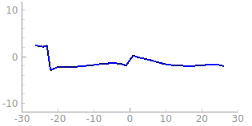
Problem: Channel Changes, Even in Static Conditions
Phase
Frequency Bins
Notes:
There is one big problem. Even if everything is the same in the environment, the wireless channel will keep changing. This means that any model you train using these channel measurements will be confused by the randomness and will not be able to learn how wireless channels connect to the underlying environment.

Slide 34
Problem: Channel Changes, Even in Static Conditions
Reason 1: Carrier Frequency Offsets (CFO)
Notes:
Secondly, there are carrier Frequency Offsets caused by frequency misalignment between the base station and the clients.

Slide 35
Problem: Channel Changes, Even in Static Conditions
Reason 2: Packet detection delay
RF Front End
$∆t$
Decoding Chain
Notes:
Finally, there is packet detection delay because of the time delay between the signal reaches the front end of the hardware and the time it actually gets detected by the decoding chain. And these hardware offsets and variations are impossible to remove.

Slide 36
Problem: Channel Changes, Even in Static Conditions
Reason 2: Packet detection delay
Problem: Impossible to remove these hardware offsets and variations
Notes:
want
Our solution is to normalize channel values so that one physical configuration corresponds to one channel value.

Slide 37
Problem: Channel Changes, Even in Static Conditions
Reason 2: Packet detection delay
Problem: Impossible to remove these hardware offsets and variations
Want: One physical configuration -> One channel value
Notes:
want
Our solution is to normalize channel values so that one physical configuration corresponds to one channel value. Based on this, we proposed the channel transformation technique.

Slide 38
Key Intuition: We care about relative channels
Channel Estimation Matrix H
$$H:\#Antennas×\#Bins$$
$$H=\left[\begin{matrix}h_{11} & ⋯ & h_{1N} \\ ⋮ & ⋱ & ⋮ \\ h_{K1} & ⋯ & h_{KN}\end{matrix}\right]$$
Relative channels must be preserved across antennas
Notes:
The key intuition behind our method is that we only care about relative channels. This is because MIMO techniques care about relative channels across different antennas rather than the absolute channel values. What we want to do is preserve these relative channel values and still have one channel value corresoponding to one physical state. Note that, the channel matrix is two dimensional, one is the antenna that we talked about earlier, the other is the ofdm subcarriers.

Slide 39
Transformation 1: Normalize Clock Offsets
Channel Estimation Matrix H
$$H:\#Antennas×\#Bins$$
$$H_{1}=\frac{H_{ }}{H_{ }(0, ∗)}$$
Channel values at the first antenna
Notes:
Secondly, since CFO adds the same phase offset across antennas, we can divide the H with channel values at the first antenna to eliminate it.

Slide 40
Transformation 2: Normalize Packet Detection Delay
Phase
Time delay $∆t→2πf∆t$
Frequency Bins
Phase of the channel for antenna 1
Notes:
Finally, we normalize packet detection delay. Let’s take a closer look at the phase of a channel matrix for antenna no.1. The x axis is frequency of ofdm bins and y axis is phase.

Slide 41
Transformation 2: Normalize Packet Detection Delay
Phase
Linear Regression
Slope= $k=2π∆t$
Time delay $∆t→2πf∆t$
Frequency Bins
Phase of the channel for antenna 1
Notes:
Finally, we normalize packet detection delay. Let’s take a closer look at the phase of a channel matrix for antenna no.1. The x axis is frequency of ofdm bins and y axis is phase.
If we do a linear regression on it, it will get a slope value that contains the delta t which hardware detection delay information. Thus we can use cancel the hardware detection delay using this. By doing these transformations, we find that we can remove that randomness and yet preserve the relative channel.
And apply to all the other antennas.

Slide 42
In this talk: Zero Channel Feedback
Problem: What is channel feedback?
FIRE: End-to-end Machine Learning to remove channel feedback.
Evaluation using public datasets and our hardware testbed
Notes:
Now, let’s look into the evaluation of FIRE using public datasets and our hardware testbed.

Slide 43
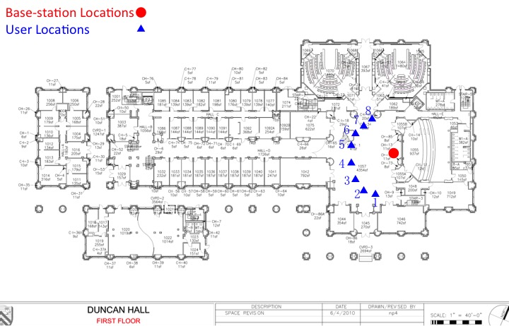
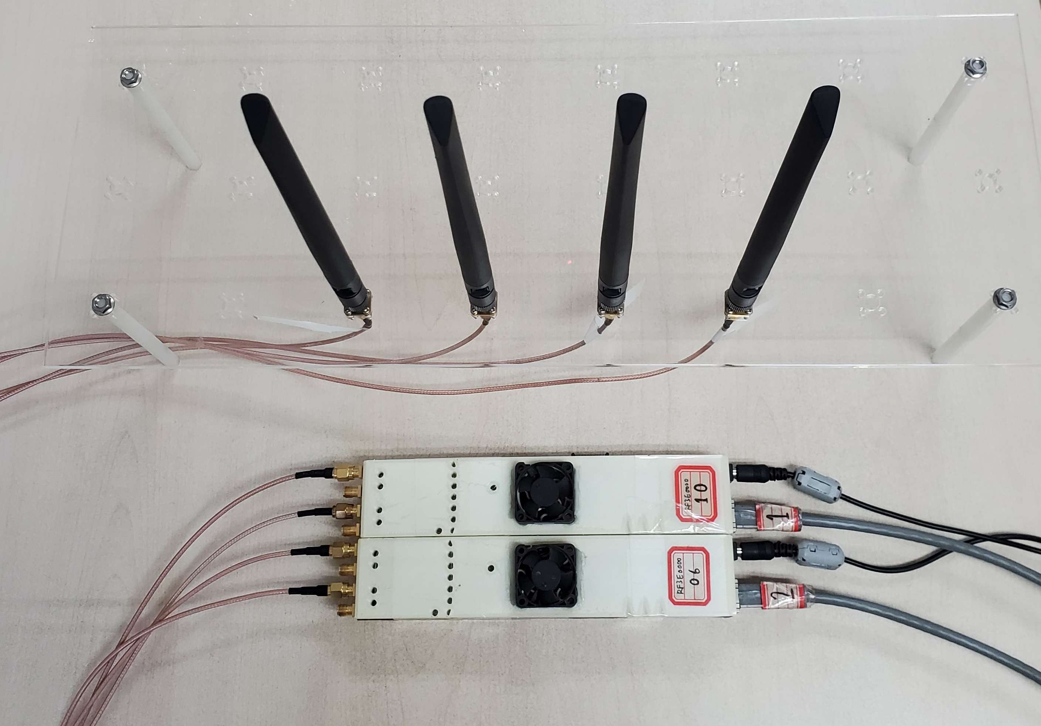
Evaluation
Argos Dataset* with up to 64 antennas
Custom hardware platform using Iris radios
*https://renew.rice.edu/datasets.html
Notes:
We first evaluate on the Argos dataset with up to 64 antennas and 8 users. Then we validate the performance on our own hardware platform with 4 antennas in FDD mode

Slide 44
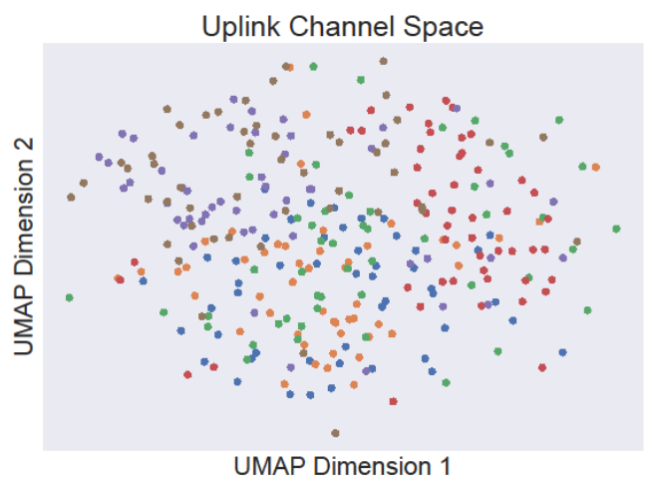
Do we encode physical information?
Reduce Channel Matrix Dimension to 2
Dimension 2
Dimension 1
Uplink Channel Space
Notes:
First, Do we encode physical information? To highlight this point, we show case a simple experiment. We first use the uplink channel matrices collected from six clients placed at six different locations. Different color means different clients. As shown, clients (denoted by different colors) are randomly scattered across the 2-D space, showing intense entanglement between uplink channels from different clients

Slide 45
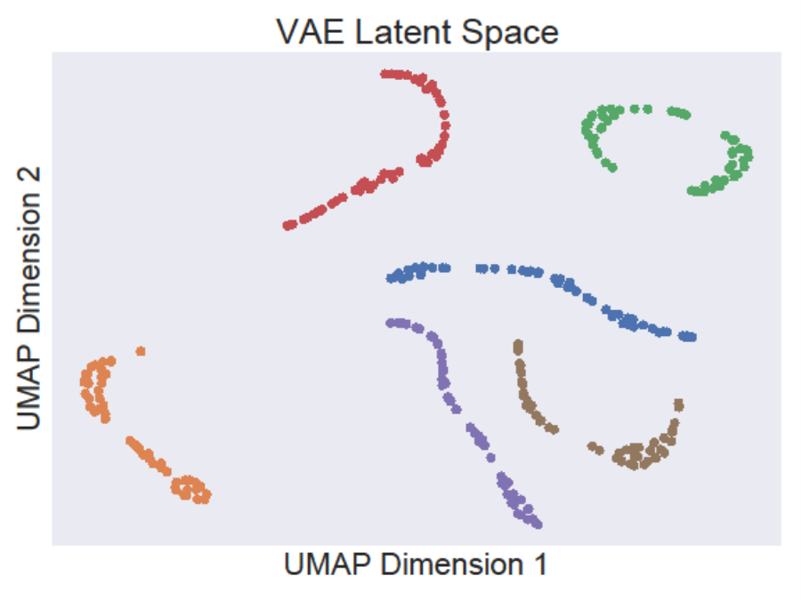
Do we encode physical information?
Reduce Channel Matrix Dimension to 2
Dimension 2
Dimension 2
Dimension 1
Dimension 1
Uplink Channel Space
Latent Space
Notes:
Next, we perform the same analysis on the latent space learnt by our VAE and plot the 2-D representation. In the figure, the clients at different locations form different clusters indicating
that the different locations get mapped to different points in our latent space. This shows that we are able to encode physical information in the latent space even though we don’t directly train for it

Slide 46
Channel Prediction Accuracy on Hardware Platform
SNR = log($\left\|H\right\|$/Prediction error)
CDF
SNR (dB)
Notes:
The red line is FIRE’s performance and it achieves the median SNR gain of 1.68 folds compared to R2F2. This result validates FIRE’s performance for a bidirectional FDD dataset collected on our hardware platform.

Slide 47
Channel Prediction Accuracy on Hardware Platform
SNR = log($\left\|H\right\|$/Prediction error)
CDF
SNR (dB)
Notes:
The red line is FIRE’s performance and it achieves the median SNR gain of 1.68 folds compared to R2F2. This result validates FIRE’s performance for a bidirectional FDD dataset collected on our hardware platform.

Slide 48
Channel Prediction Accuracy on Hardware Platform
SNR = log($\left\|H\right\|$/Prediction error)
CDF
SNR (dB)
Notes:
The red line is FIRE’s performance and it achieves the median SNR gain of 1.68 folds compared to R2F2. This result validates FIRE’s performance for a bidirectional FDD dataset collected on our hardware platform.

Slide 49
Massive MIMO Results on Argos
SINR = log($\left\|H\right\|$/Interference+Noise)
Increase number of antennas
Notes:
Next, we evaluate how fire channel prediction works with massive mimo techiniques. Our hardware platform only has four antennas so to evalute massive mimo, we use Argos dataset. We let the base station conduct beamforming towards two different clients and calculate the signal to interference plus noise ratio. More accurate downlink channel estimation will bring more accurate beams and decrease the interference between two clients, thus higher SINR. We increase the number of antennas at the base station to evaluate the scaling performance of FIRE.

Slide 50
Massive MIMO Results on Argos
SINR(dB)
Antenna Number
Notes:
Then let’s look into the mssaive MIMO results on Argos dataset. In this graph, I am gonna plot the SINR achieved by different baselines when antenna number scales up.

Slide 51
Massive MIMO Results on Argos
SINR(dB)
16.24
Antenna Number
Notes:
All base lines SINR increase when antenna number goes up. because increasing the number of antennas allows the base station to cancel interference better and to focus its narrower beams on the intended client. However, the baselines cannot fully leverage this because of the errors in their channel predictions and are limited to the best value of 16.20 dB at 64 antennas.

Slide 52
Massive MIMO Results on Argos
1.79x
SINR(dB)
Antenna Number
Notes:
Finally, we plot the SINR achieved by FIRE. IT achieves 29.11dB at 64 annteas case and it’s 1.79times higher than R2F2. This result shows that FIRE has the ability to accurately predict the downlink channel and conduct the massive mimo applications.

Slide 53
Related Works
Downlink Channel Prediction: R2-F2 (SIGCOMM 2016), OptML (MobiCom 2019), FNN(2016), ICC 2019, IEEE Access 2019, ACSSC 2019, …
Throughput
High
FIRE
Explicit
Feedback
R2F2
OptML
Codebook
Low
Zero
High
Overhead
Notes:
FIRE is also inspired from this line of work that uses ML in wireless systems. We differ from this line of work both in terms of the task as well as techniques.

Slide 54
Related Works
Downlink Channel Prediction: R2-F2 (SIGCOMM 2016), OptML (MobiCom 2019), FNN(2016), ICC 2019, IEEE Access 2019, ACSSC 2019, …
Machine Learning in Wireless Systems: Indoor positioning (Mobicom 2020, ICCE 2018), MIMO systems(ITA 2018, TWC 2019), MAC protocol design (NSDI 2020, ICE2T 2017), human sensing (CVPR 2018, SIGCOMM 2018), …
Throughput
High
FIRE
Explicit
Feedback
R2F2
OptML
Codebook
Low
Zero
High
Overhead
Notes:
FIRE is also inspired from this line of work that uses ML in wireless systems. We differ from this line of work both in terms of the task as well as techniques.

Slide 55
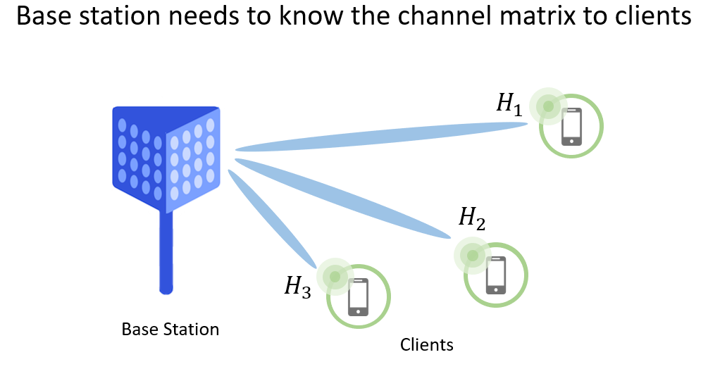
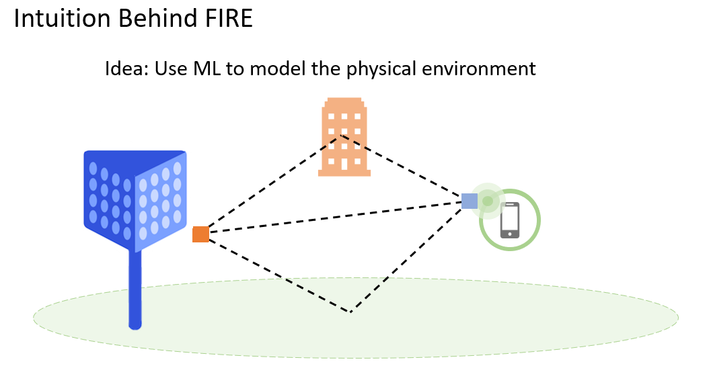
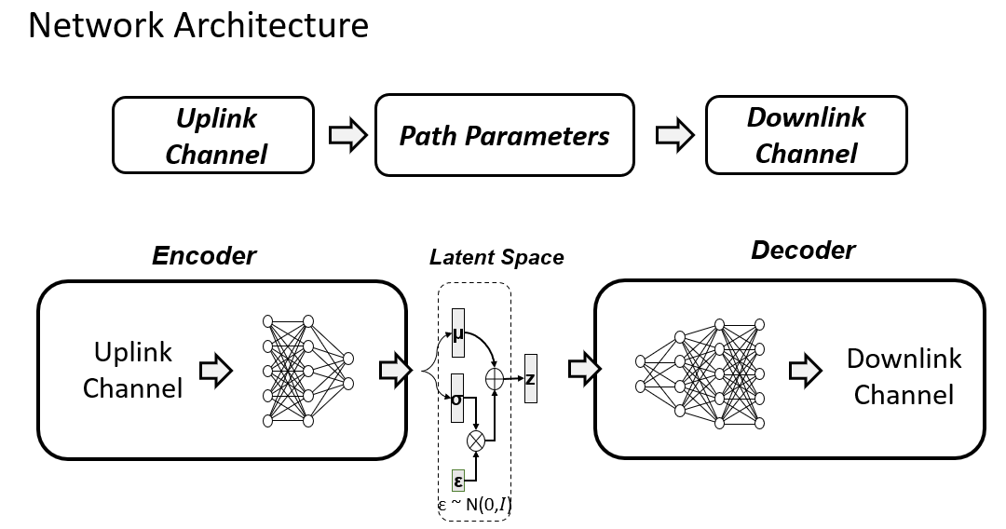
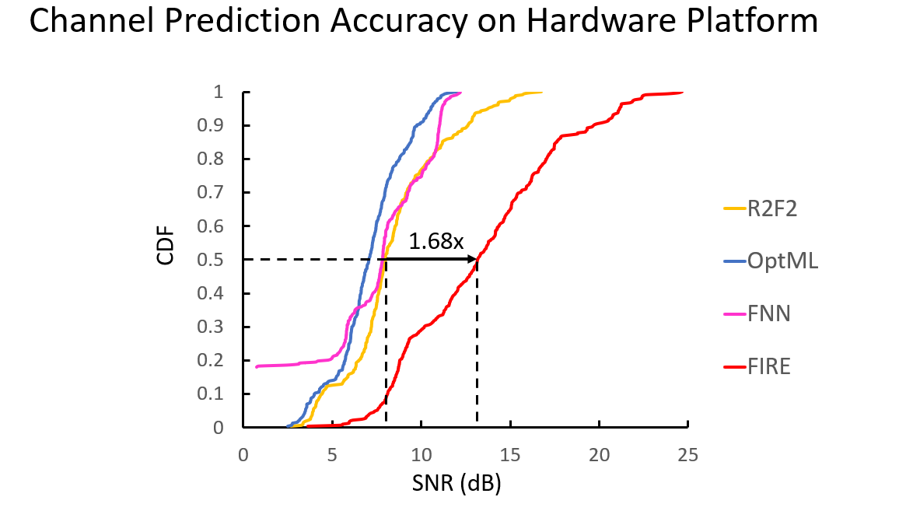
Conclusions
Notes:
To conclude, FIRE is an end-to-end machine learning based downlink prediction method using VAE and augmented with channel preprocessing method. It achieves high accuracy and enable 5G applications on both open-source dataset and our own hardware platform. We envision computational tools such as FIRE will sit at the core of new radio designs and form the core of future 5G and 6G deployments.
To conclude, as we move to 5G and 6G, increasingly a lot of the network functions are moving to the cloud, both in the RAN and the network core. This means that collecting data to train ML based systems and deploying mL based systems will become easier with time. We envision computational tools such as FIRE will sit at the core of new radio designs and form the core of future 5G and 6G deployments.

